Slide 1

Unit - 11 Database Design
Dr. Asif Sohail University of the Punjab
Department of Information Technology, FCIT

Slide 2
Database Design
It is a process of creating a design that will support the organization’s objectives for the required database system.
There are two main approaches to database design:
Bottom-up Approach
Top-down Approach

Slide 3
Bottom-up Approach (design by synthesis)
Database Design
It begins with the fundamental level of attributes, which through analysis of the associations between attributes, are grouped into relations.
The process of Normalization is used to find the normalized relations based on functional dependencies between the attributes.
The bottom-up approach is appropriate for the design of simple databases with relatively small number of attributes.
This approach becomes difficult to use with a larger number of attributes, where it is difficult to establish all the functional dependencies between the attributes.

Slide 4
Top-down Approach (design by analysis)
Database Design
It starts with a number of groupings of attributes into relations that exist together naturally, for example, an invoice.
The relations are then analyzed through normalization.
One may start with the development of ER model, beginning with the identification of entities and relationships between the entities, which are of interest to the organization.
The ER model is then transformed into a set of relations using the appropriate rules for conversion.

Slide 5
Phases of Database Design
Database design is an iterative process.
Database design is made up of three main phases:
Conceptual database design
Logical database design
Physical database design
Notes:
Chapter 16 – 18 (Connolly)

Slide 6
Conceptual database design
Phases of Database Design
The process of constructing a model of the data used in an enterprise, independent of all physical considerations, such as the target DBMS software, application programs, programming language, hardware platform etc.
The data model is built using the user’s requirements specification document.

Slide 7
Steps of Conceptual database design
Phases of Database Design
Identify entity types
Identify relationship types
Identify and associate attributes with entity or relationship types
Determine attribute domains
Determine candidate, primary, and alternate key attributes
Consider use of enhanced modeling concepts (optional step)
Check model for redundancy
Validate conceptual data model against user transactions
Review conceptual data model with user
Notes:
Check model for redundancy
(1) re-examine one-to-one (1:1) relationships; (for entity merging)
(2) remove redundant relationships;
(3) consider time dimension.

Slide 8
Logical database design
Phases of Database Design
The process of constructing a model of the data used in an enterprise based on a specific data model.
The logical data model is based on the target model for the database, such as the relational data model.
The technique of normalization is used to test the correctness of the logical data model.

Slide 9
Steps of Logical database design
Phases of Database Design
Derive relations for logical data model
Validate relations using normalization
Validate relations against user transactions
Check integrity constraints
Review logical data model with user
Merge logical data models into global model (optional step)
Check for future growth

Slide 10
Physical database design
Phases of Database Design
The process of producing the description of the database on the secondary storage; it describes the base relations, file organizations, and indexes used to achieve efficient access to the data.
Physical database design is tailored to a specific DBMS.
Logical database design is concerned with what, physical database design is concerned with how.

Slide 11
Steps of Physical database design
Phases of Database Design
Design base relations
Design representation of derived data
Design general constraints
Design file organization and indexes
Coding and Compression Techniques
Analyze transactions
De-normalization
Partitioning
Estimate disk space requirements
Design user views
Design security mechanism

Slide 12
Design base relations
Physical Database Design
For each relation defined in the logical data model, we have a definition consisting of:
The name of the relation and its attributes
Key attributes
Integrity constraints
For each attribute, we have:
Its domain, consisting of its data type, length, and any constraint on the domain
An optional default value for the attribute
Whether the attribute can hold nulls
Whether the attribute is derived and, if so, how it should be computed?

Slide 13
Derived data
Physical Database Design
Whether a derived attribute is stored in the database or calculated every time it is needed is a tradeoff. The designer should calculate:
The additional cost to store the derived data and keep it consistent with operational data.
The cost to calculate each time it is required.
The less expensive option is chosen subject to performance constraints.
Derived attribute should be stored when:
A frequent query is made against it.
The DBMS’s query language cannot easily calculate the derived attribute.

Slide 14
Design general constraints
Physical Database Design
Constraints are designed to enforce business rules and the correctness of data.
The constraints defined at physical database design can greatly reduce the programming effort at the application level.
We can introduce constraints such as DEFAULT value, CHECK constraint, Referential Integrity, database triggers etc.

Slide 15
File organization
A database is mapped into a number of different files that are maintained by the underlying operating system.
A file is organized logically as a sequence of records that are mapped onto disk blocks.
Fixed length records
Variable length records
The simplest file organization is to store the records as per the sequence of insert operations.
Possible actions in response to a delete operation?
Move the record that comes after it into the space formerly occupied by the deleted record, and so on, until every record following the deleted record has been moved ahead.
Move the final record of the file into the space occupied by the deleted record
Wait for a subsequent insertion to utilize the space occupied by the deleted record. This requires additional structure (file header).

Slide 16
File organization
File header or file descriptor contains metadata of a file plus the address of the first deleted record.
The addresses of the deleted records are maintained in link list as shown in the figure below.

Slide 17
File organization
Variable length Records
The representation typically has two parts: an initial part with fixed-length information, whose structure is the same for all records of the same relation, followed by the contents of variable-length attributes.
Variable-length attributes are represented by a pair (offset, length), where offset denotes where the data for that attribute begins within the record, and length is the length (in bytes) of the attribute.
Consider a relation EMP (ID, eName, job, sal)
The attributes are ID, eName, job are variable-length attributes, and sal is fixed length attribute of 8 bytes.
Assuming that the offset and length use 2 bytes each, representation of a variable length record of EMP is shown below.
Bit 1 in NULL bitmap at a certain position indicates NULL value of an attribute.

Slide 18
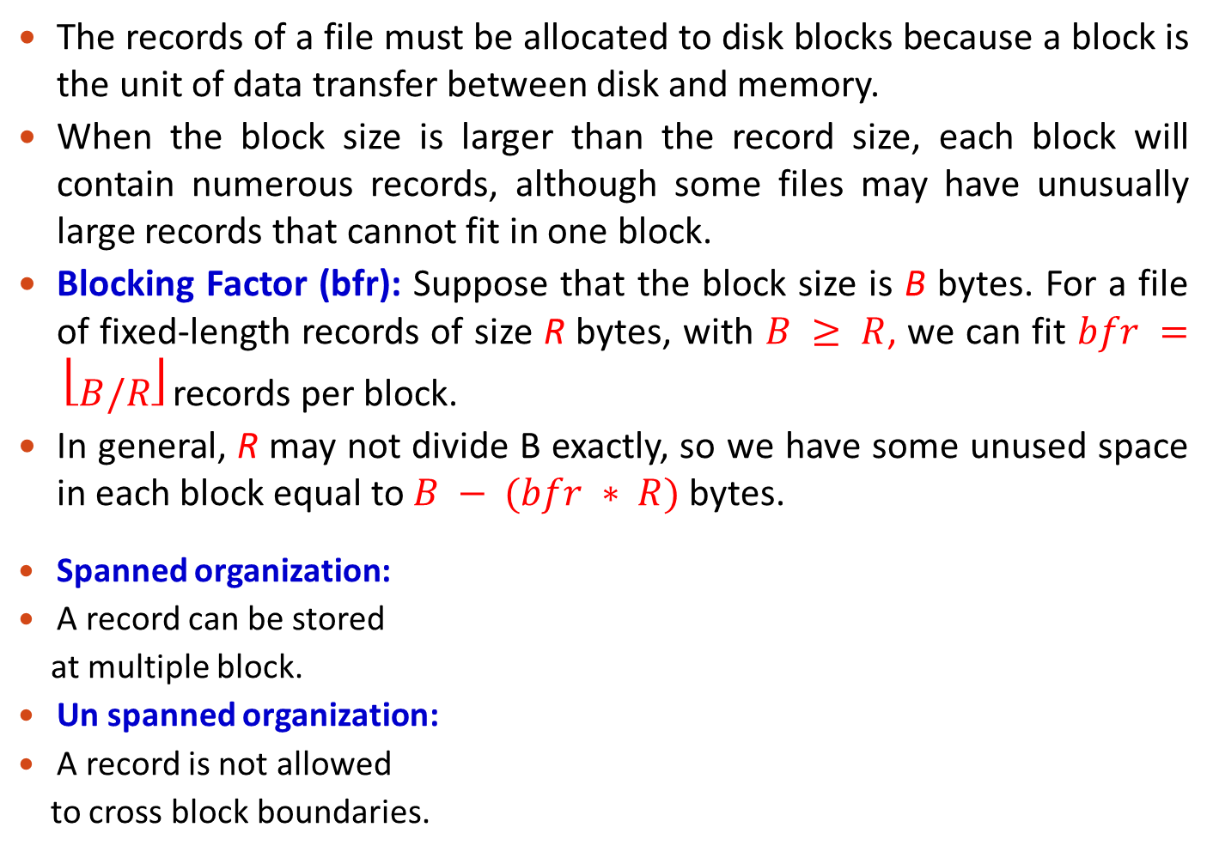
Record Blocking
The records of a file must be allocated to disk blocks because a block is the unit of data transfer between disk and memory.
When the block size is larger than the record size, each block will contain numerous records, although some files may have unusually large records that cannot fit in one block.
Blocking Factor (bfr): Suppose that the block size is B bytes. For a file of fixed-length records of size R bytes, with $B ≥ R$, we can fit $bfr = ⎣B/R⎦$ records per block.
In general, R may not divide B exactly, so we have some unused space in each block equal to $B − (bfr ∗ R)$ bytes.
Spanned organization:
A record can be stored
at multiple block.
Un spanned organization:
A record is not allowed
to cross block boundaries.

Slide 19
Record Blocking
The blocks of a file can be allocated on the disk in the following ways:
a) Contiguous Allocation: The file blocks are allocated to consecutive disk blocks. This makes reading the whole file very fast, but it makes expanding the file difficult.
b) Linked Allocation: Each file block contains a pointer to the next file block. This makes it easy to expand the file but makes it slow to read the whole file.
c) Cluster Allocation: It is a combination (a) and (b). It allocates clusters of consecutive disk blocks, and the clusters are linked. Clusters are sometimes called file segments or extents.
d) Indexed Allocation: One or more index blocks contain pointers to the actual file blocks.

Slide 20
Organization of Records in Files
Heap or pile or unordered file. Any record can be placed anywhere in the file where there is space for the record. There is no ordering of records.
Sequential or sorted file. Records are stored in sequential order, according to the value of a "sort key" of each record.
Indexed Sequential file.
Hashed file. Place of a record is determined using a hash function applied to a particular field called hash key“.

Slide 21
Organization of Records in Files
Insertion in Sequential file
Locate the record in the file that comes before the record to be inserted in search key order.
If there is a free record (i.e., space left after a deletion) within the same block as this record, insert the new record there.
Otherwise, insert
the new record in an
overflow block.
If too many overflow
blocks are generated
over time, the file
should be reorganized.

Slide 22
File organization and indexes
Physical Database Design
To determine the optimal file organizations to store the base relations and the indexes that are required to achieve acceptable performance; that is the way in which relations and tuples will be held on the secondary storage.
In many cases, a RDBMS may give little or no choice for choosing file organization, although some may be established as indexes are specified.
An index should be used against an attribute:
That is used most often for join operations.
That is used most often to access the tuples in a relation.
The columns frequently involved in ORDER BY and GROUP BY clause.
The column contains a wide range of values.
An index on primary key is called primary index and an index on non key is secondary index.

Slide 23
Coding and Compression Techniques
Physical Database Design
Coding techniques are useful for compression of data values, by replacing those data values with the smaller sized codes.
Consider the following relation:
EMP (EmpNo, Ename, Job, City,…….)
If we have large number of records, then the wastage of small amount of space in each record can lead to loss of huge amount of data storage space.
To avoid the above problem, we can use the following relations:
EMP (EmpNo, Ename, JobCode, CityCode,…….)
Job (JobCode, JobTitle)
City (CityCode, CityName)

Slide 24
Analyze transactions
To understand the functionality of the transactions that will run on the database and to analyze the important transactions.
For efficient database design, it is necessary to have knowledge of the transactions or queries that will run on the database. It includes the identification of frequent transactions, the transactions that are critical, peak load time etc.
It has been suggested that the most active 20% of user queries account for 80% of the total data access (80/20 Rule).
Transaction relation cross-reference matrix shows the operation a transaction performs on a certain relation.
Transaction usage map diagrammatically indicates which relations are potentially heavily used.
The above information will be used to select appropriate file organizations and indexes.

Slide 25
Transaction / relation cross-reference matrix
Transaction / Relation | T1 | T2 | . . . . . . | Tm
 | I R U D | I R U D | . . . . . . | I R U D
R1 | X X | X X |  | X
R2 | X | X X |  | X X X
. . . | . . . | . . . | . . . | . . .
Rn | X | X X |  | X
I = Insert; R = Read; U = Update; D = Delete

Slide 26
Denormalization
Physical Database Design
Denormalization is a technique to move from higher to lower normal forms of database modeling in order to speed up database access.
A fully normalized database schema can fail to provide adequate system response time due to excessive table join operations.
Denormalization results in combining two relations into one relation. More specifically, in this step, we consider duplicating certain attributes or combining relations together to reduce the number of joins required to perform a query.
As a general rule of thumb, if performance is unsatisfactory and a relation has a low update rate and very high query rate, denormalization may be a viable option.
Notes:
When Not to Create an Index
The table is small.
The columns are not often used as a condition in the query.
Most queries are expected to retrieve more than 2–4% of the rows.
The table is updated frequently. If you have one or more indexes on a table, the DML statements that access the table take more time.
Class Management Note
Null values are not included in the index. To optimize joins, you can create an index on the FOREIGN KEY column, which will speed up the search to match rows to the PRIMARY KEY column. The optimizer does not use an index if the WHERE clause contains the IS NULL expression.

Slide 27
Denormalization
Physical Database Design
Denormalization Situation 1:
Many to many binary relationships mapped to three relations.
EMP (empID, eName, job, Sal)
PROJ (pjId, pjName)
WORK (empID, pjId, dtHired)
By de-normalizing these relations, we merge the WORK relation with PROJ relation. In this case it is violating 2NF and anomalies of 2NF would be there, but there would be only one join operation involved by joining two tables, which increases the efficiency.
EMP (empID, eName, job, Sal)
PROJ (pjId, pjName, empId, dtHired)
Notes:
When Not to Create an Index
The table is small.
The columns are not often used as a condition in the query.
Most queries are expected to retrieve more than 2–4% of the rows.
The table is updated frequently. If you have one or more indexes on a table, the DML statements that access the table take more time.
Class Management Note
Null values are not included in the index. To optimize joins, you can create an index on the FOREIGN KEY column, which will speed up the search to match rows to the PRIMARY KEY column. The optimizer does not use an index if the WHERE clause contains the IS NULL expression.

Slide 28
Denormalization
Denormalization Situation 2:
We have attributes that are almost always used together in application and they end up in different relations, then we will always have to perform a join operation when we retrieve them.
Example: Consider the following relation:
EMP (empID, eName, street, postcode, city)
The relation isn’t in 3NF, as it has a transitive dependency postcode -> city.
After converting the above relation into 3NF, we have
EMP (empID, eName, street, postcode)
LOCATION (postcode, city)
However, this would mean that we would have to do a join whenever we want a complete address for a person. In this case, we would settle for 2NF and implement the original EMP relation.
An alternative is to additionally store the join of EMP and LOCATION as a materialized view (A view whose result is stored in the database and brought up to date when the relations used in the view are updated.)

Slide 29
Partitioning
Physical Database Design
De-normalization leads to merging different relations, whereas partitioning splits same relation into two.
The general aims of data partitioning and placement in database are to
Reduce workload (e.g. data access, communication costs, search space)
Balance workload
Efficiency
There are two types of partitioning:-
Horizontal Partitioning
Vertical Partitioning
Notes:
When Not to Create an Index
The table is small.
The columns are not often used as a condition in the query.
Most queries are expected to retrieve more than 2–4% of the rows.
The table is updated frequently. If you have one or more indexes on a table, the DML statements that access the table take more time.
Class Management Note
Null values are not included in the index. To optimize joins, you can create an index on the FOREIGN KEY column, which will speed up the search to match rows to the PRIMARY KEY column. The optimizer does not use an index if the WHERE clause contains the IS NULL expression.

Slide 30
Partitioning
Physical Database Design
Horizontal Partitioning
Table is split on the basis of rows, which means a larger table is split into smaller tables.
Now the advantage of this is that time in accessing the records of a larger table is much more than a smaller table.
It also helps in the maintenance of tables, security, authorization and backup.
These smaller partitions can also be placed on different disks to reduce disk contention.
Notes:
When Not to Create an Index
The table is small.
The columns are not often used as a condition in the query.
Most queries are expected to retrieve more than 2–4% of the rows.
The table is updated frequently. If you have one or more indexes on a table, the DML statements that access the table take more time.
Class Management Note
Null values are not included in the index. To optimize joins, you can create an index on the FOREIGN KEY column, which will speed up the search to match rows to the PRIMARY KEY column. The optimizer does not use an index if the WHERE clause contains the IS NULL expression.

Slide 31
Partitioning
Physical Database Design
Vertical Partitioning
It is done on the basis of attributes. Same table is split into different physical records depending on the nature of accesses.
Primary key is repeated in all vertical partitions of a table to get the original table.
You can replicate a limited subset of a table's columns to other machines.
Notes:
When Not to Create an Index
The table is small.
The columns are not often used as a condition in the query.
Most queries are expected to retrieve more than 2–4% of the rows.
The table is updated frequently. If you have one or more indexes on a table, the DML statements that access the table take more time.
Class Management Note
Null values are not included in the index. To optimize joins, you can create an index on the FOREIGN KEY column, which will speed up the search to match rows to the PRIMARY KEY column. The optimizer does not use an index if the WHERE clause contains the IS NULL expression.

Slide 32
Estimate disk space requirements
Physical Database Design
This step is required so that the appropriate disk size can be selected.
In general, the estimate is based on the size of each tuple and the number of tuples in a relation.
The growth of the relation should also be taken into consideration.
Notes:
When Not to Create an Index
The table is small.
The columns are not often used as a condition in the query.
Most queries are expected to retrieve more than 2–4% of the rows.
The table is updated frequently. If you have one or more indexes on a table, the DML statements that access the table take more time.
Class Management Note
Null values are not included in the index. To optimize joins, you can create an index on the FOREIGN KEY column, which will speed up the search to match rows to the PRIMARY KEY column. The optimizer does not use an index if the WHERE clause contains the IS NULL expression.

Slide 33
Design user views
Physical Database Design
A View is a subset of the database that is presented to one or more users.
A view is often referred to as a virtual table.
Views are created to satisfy the requirements of multiple users in an efficient way.
Notes:
When Not to Create an Index
The table is small.
The columns are not often used as a condition in the query.
Most queries are expected to retrieve more than 2–4% of the rows.
The table is updated frequently. If you have one or more indexes on a table, the DML statements that access the table take more time.
Class Management Note
Null values are not included in the index. To optimize joins, you can create an index on the FOREIGN KEY column, which will speed up the search to match rows to the PRIMARY KEY column. The optimizer does not use an index if the WHERE clause contains the IS NULL expression.

Slide 34
Database Access Control
Database access control is the process of making sure that data or other resources are accessed only in authorized ways.
Access Control Matrix or Authorization Table is used to describe the access type or actions that a database user can perform on a given database object.
It expresses the Authorization Rules in the form of a table or matrix that include Subject, Object & Privileges.
SUBJECT | Student Table | Result Table | Faculty View | Adm. Procedure | CREATE TABLE
User A | Read | Read | Null | Null | No
User B | Read/ Write | Read | Read | Execute | Yes
Role A | All | All | Read, Write, Update | Execute, Alter | Yes

Slide 35
Database Access Control
Physical Database Design
The Column Headings represent database objects, which may be tables, Views, Sequence, Indexes etc.
The Subjects are written on the left side of the table. It may be an individual or a group of users.
The Cell entries of the table specify the privileges. These include INSERT, UPDATE, DELETE, ALTER, SELECT
Once the Authorization table or Access Control Matrix is complete, the DBA grants the privileges accordingly.
Notes:
When Not to Create an Index
The table is small.
The columns are not often used as a condition in the query.
Most queries are expected to retrieve more than 2–4% of the rows.
The table is updated frequently. If you have one or more indexes on a table, the DML statements that access the table take more time.
Class Management Note
Null values are not included in the index. To optimize joins, you can create an index on the FOREIGN KEY column, which will speed up the search to match rows to the PRIMARY KEY column. The optimizer does not use an index if the WHERE clause contains the IS NULL expression.

Slide 36

Thank you for your attention.
Dr. Asif Sohail
Assistant Professor
Department of Information Technology,
Faculty of Computing and Information Technology (FCIT)
University of the Punjab, Lahore, Pakistan
Tel: +92-(0)42-111-923-923 Ext. 154
E-mail: asif@pucit.edu.pk

